Slide 2
Core Business Application Security (CBAS)
SAP Maturity Model (SMM)

Slide 3
Introduction
The Core Business Application Security (CBAS) – SAP Maturity Model aims to aid and support organizations with their cybersecurity strategy when dealing with SAP applications.
It allows organizations to determine their current maturity level in protecting SAP resources and enables them to plan and increase their maturity level through different controls.

Slide 4
01
Introduction
Content
Standards and methodologies
Maturity Model
Maturity Levels
Maturity Identification
Discussion
Controls:
Control Identification
Control Structure
Control Stages
Discussion
Future Directions

Slide 5
01
Standards and Methodologies

Slide 6
01
Standards and Methodologies
References:
SAP Baseline V2.0
BSI standards – 4.2 SAP ERP system & 4.6 SAP ABAP programming
ISO 27001
CIS controls
COBIT
NIST 800-53 Rev. 4
The SAP maturity model is based and categorized by:
NIST Security Functions
IPAC Model
(NO MONKEY Security Matrix)
The references are used to derive controls and to align SAP security strategy with the overall cybersecurity strategy of the company.

Slide 7
01
Standards and Methodologies
NO MONKEY Security Matrix
The NO MONKEY Security Matrix will be used to give a clear picture of the main risk points within the matrix and enable organizations to concentrate their efforts on areas that require immediate attention.
NO MONKEY Security Matrix will be used to:
Identify risk areas across the matrix
Show number of controls in each area
Align resources to eliminate or mitigate high risk areas
Map to the CBAS – Security Aptitude Assessment**

Slide 8
02
Maturity Model

Slide 9
02
Maturity Model
Maturity Levels
Defined controls are based on 3 different maturity levels. Maturity levels are based on standards, baselines, and methodologies.
Concepts:
[ ] Running controls through a specific threat model
[ ] Defining a specific control to run across all the NIST security function
Maturity levels:
Maturity level 1 – based on SAP baseline v2.0 & BSI 4.2 & 4.6 (critical missing areas will be covered)
Maturity level 2 – Controls that enhance the baseline by adding additional security mechanisms
Maturity level 3 - Controls that cover the entire NO MONKEY Security Matrix

Slide 10
02
Maturity Model
Maturity Identification
Maturity levels of a specific organization are identified through the areas listed.
Control implementation
Addressed risk in the NO MONKEY Security Matrix

Slide 11
02
Maturity Model
Maturity Levels – Discussion
Concepts in defining a control for maturity level 2 and 3:
Concepts:
[ ] Running controls through a specific threat model
[ ] Defining a specific control to run across all the NIST security function
Maturity level 1 – based on SAP baseline v2.0 & BSI 4.2 & 4.6 (critical missing areas will be covered)

Slide 12
03
Controls

Slide 13
03
Controls
Controls Identification
We aim to create controls in a structured, easy and understandable way
Every control follows the same identification schema and structure
Markdown language used for controls
Excel to present maturity level, risk areas within the NO MONKEY Security Matrix, implementation status, and many more
Control Identification:
NIST Security Function
NIST Category
IPAC Model
SAP Technology
Maturity Level
Element/Defender (People, Process, Technology)
Notes:
For non-SAP security professionals

Slide 14
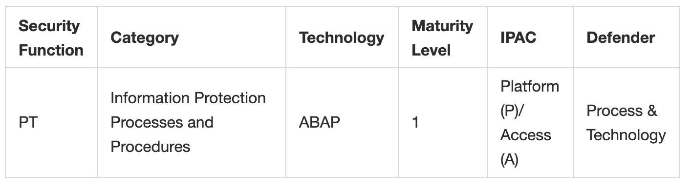
03
Controls
Example - Control Identification

Slide 15
03
Controls
Control Structure
The control structure aims to achieve the below goals:
Describe the control in a way that is understandable and clear
Non-SAP security professionals should be able to implement the control
Verification method for every control allows to decrease lack of visibility within SAP applications
References that enable organizations to map controls to the overall cybersecurity strategy
Control Structure:
Description
Implementation
Verification of control
References

Slide 16
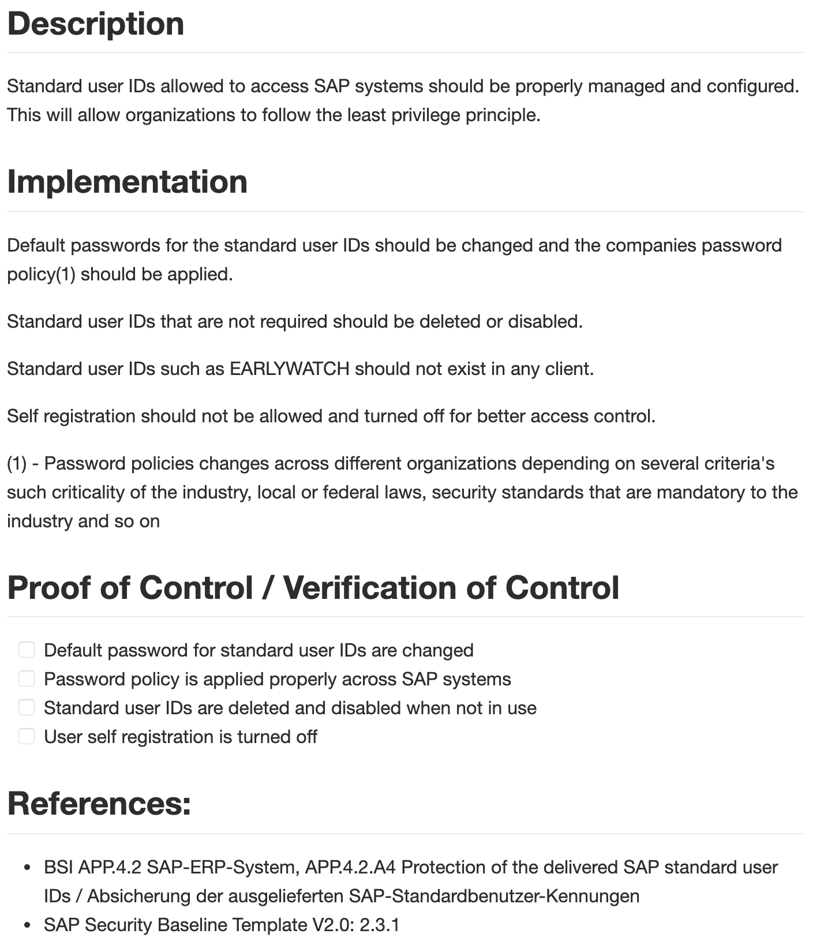
03
Controls
Example - Control Structure

Slide 17
03
Controls
Control Stages
Controls are valued by three different elements:
Maturity level
Control risk value – predefined**
Control Implementation stage
This allows organizations to:
Identify high risk areas and controls
Distribute resources to mitigate or eliminate high risks
Identify SAP security posture and strategy
Control Stages:
Implemented
Implemented and Maintained
Implemented, Maintained, and Monitored
Implemented, Maintained, Monitored, and Reviewed
Not Implemented

Slide 18
03
Controls
Controls – Discussion
Reminder on what we have presented in this section:
Controls identification
Control structure
Control stages
Control value
Controls are valued by three different elements:
Maturity level
Control Implementation stage
Control risk value – predefined **
Notes:
Control risk value – predefined: discussion point. Determine whether this can be verified or makes sense to put. Does it bring additional overhead? Can it properly be measured? (i.e. a control risk value is defined by the amount of importance/threat/risk a specific control contains if it is not implemented)

Slide 19
04
Future Directions

Slide 20
04
Future Directions
NI
I
IM
IMM
IMMR
Not implemented
Implemented by IT/Security Team
Implemented and continuously updated
Implemented, continuously updated, and monitored for changes, events…
Implemented, continuously updated, monitored and reviewed by the audit department
Communication b/w security and operation exists
Communication b/w security and audit exists
Security Department
Notes:
Discussion point

